Slide 1
DIFFERENTIATED INSTRUCTION AND INCLUSIVE EDUCATION
3
4
5
6
BY Ndefo Emeka
On 8th September, 2025
2
At Samuel Adegbite Anglican College, Idimu
1

Slide 2




OPENING SCENARIO: TAIL FRIENDS
What will be your impression about them in your class?
4
5
6
3
2
Tunde
Apollo
Ifeoma
Lami
1

Slide 3
THE PROBLEM
Imagine you are teaching a class with:
A boy who reads far above grade level
A girl struggling with dyslexia
A quiet student who prefers visual aids
A lively one who learns best through debates
If you teach them all the same way, who will win? Who will lose?
5
6
4
3
1
2

Slide 4




THE PROBLEM: Ignored Reality
5
4
Tunde
Apollo
Ifeoma
Lami
3
6

Slide 5
OBJECTIVES
Define and explain the concepts of Differentiated Instruction (DI) and Inclusive Education (IE)
Explore strategies to apply DI in SAAC classrooms
Discuss how DI promotes inclusion
Share practical tips and case studies
Reflect on how teachers can start small but scale effectively
6
5
4
7

Slide 6
KEY CONCEPTS
Differentiated Instruction (DI)
Inclusive Education (IE)
National Policy on Education (2013 revision) emphasizes inclusive education
Universal Basic Education (UBE) highlights access for all, including children with special needs
7
6
5
8

Slide 7
DIFFERENTIATED INSTRUCTION (DI)
A teaching philosophy that recognizes students’ differences in readiness, interest, and learning style, adapts instruction to meet those needs.
The teacher recognizes the differences in those students and adjusts the teaching method to match those differences.
8
7
6
9

Slide 8
INCLUSIVE EDUCATION (IE)
An approach where all learners, regardless of ability, disability, background, or social class, are educated together in the same environment with equal opportunities to participate and succeed.
9
8
10
7

Slide 9
WHY DI & IE MATTER IN NIGERIAN SECONDARY SCHOOLS
Diversity in classrooms
Learning gaps
Special needs
Equity
10
9
8
11

Slide 10
4 CORE STRATEGIES OF DI
A. Differentiating Content (What they learn)
B. Differentiating Process (How they learn)
C. Differentiating Product (How they show learning)
D. Differentiating Learning Environment
(Where/with whom they learn)
11
10
12
9

Slide 11
DIFFERENTIATING CONTENT
What the students learn.
Example: In Biology (Cell structure), advanced learners can research on cell organelles and their functions, while struggling learners may focus on identifying and labelling the basic parts of a cell.
12
11
13
10

Slide 12
DIFFERENTIATING PROCESS
How the students learn.
Example: In English Literature, while some students analyze character development in Things Fall Apart, others can role-play scenes.
13
12
14
11

Slide 13
DIFFERENTIATING PRODUCT
How the students show what they learned.
Example: In Civic Education on Human Rights, one group may write an essay, another can design a poster, another can act out a short drama.
14
13
15
12

Slide 14
DIFFERENTIATING LEARNING ENVIRONMENT
Where and with whom students learn.
Example: Allow flexible seating, peer tutoring, or quiet corners.
Encourage students to pair up based on strengths and weaknesses.
15
14
16
13

Slide 15
INCLUSIVE EDUCATION (IE)
Making DI work for all
Use Universal Design for Learning (UDL) principles
Incorporate assistive tools (low-cost options)
Smartphones for audio lessons
Chart papers for visuals
Peer note-takers for students with handwriting difficulties
Foster a culture of respect
15
16
17
14

Slide 16
USE CASES
Use Case 1 (Ibadan, Nigeria)
In a secondary school in Ibadan, a teacher grouped students for Mathematics:
Stronger students explained concepts in Yoruba to peers struggling with English
This peer-support system raised the overall class performance by 20% in term exams
17
16
18
15

Slide 17
USE CASES
Use Case 2 (Lagos, Nigeria)
In SAAC, an unusual CBT of 100 multichoice questions, consisting of 4 options each, was created for SS1 students to complete within 1 two-hours time frame. During class interaction after the expiration of the online test:
Many students found it intriguing
Few complained about not hitting 100%
One female student, who scored 73% said, “The test was boring”. Why do you think she reacted that way?
18
17
19
16

Slide 18
USE CASES
Use Case 3 (Lagos, Nigeria)
On day 1 of Summer school, during feedback interactions, some students were asked what they found interesting and not interesting. One boy in JS2 class said, “ICT was boring because the teacher kept explaining the topic that he already knows. Mathematics was interesting because the topic was new”.
What DI strategy is best fit for him?
18
19
20
17

Slide 19


ILLUSTRATED CASES
Video 1
TAIL Friends feeling sad and neglected
Why?
You failed to use DI & IE
What should you do?
20
19
21
18

Slide 20
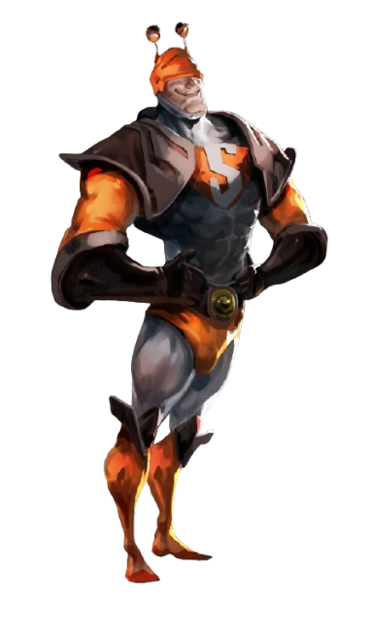

TAIL FRIENDS PERSONALITIES
Tunde
Fast Learner
[The Flash]
Apollo
Slow Learner
[The Snailman]
21
20
22
19

Slide 21
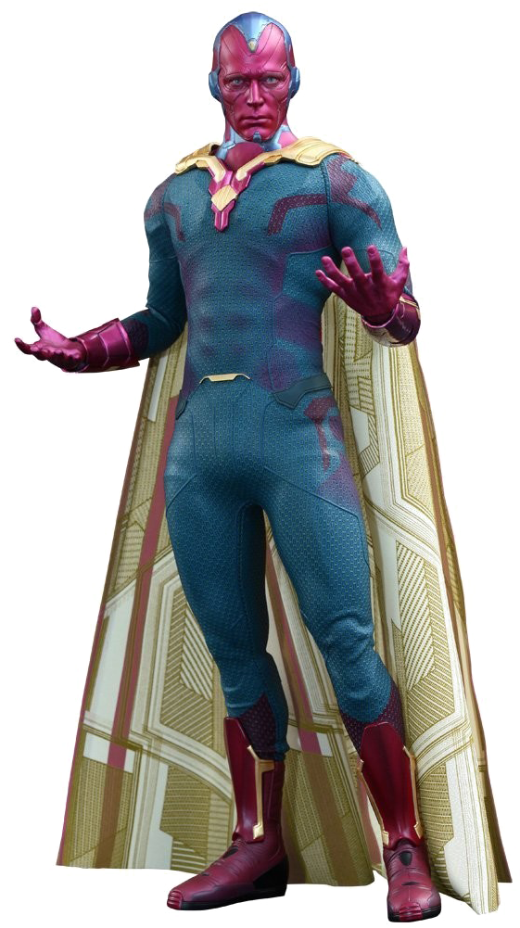

TAIL FRIENDS PERSONALITIES
Ifeoma
Visual Learner
[The Vision]
Lami
Debater
[The Hulk]
22
21
23
20

Slide 22
ILLUSTRATED CASES
Video 2
TAIL Friends feeling happy an thankful
Any benefits?
Your class becomes more lively and performance improves
23
22
24
21

Slide 23




ILLUSTRATED CASES
TAIL Friends are now very productive
24
23
25
22

Slide 24
CHALLENGES SAAC TEACHERS FACE
Large class sizes
Limited teaching aids
Limited time per period
Pressure to cover syllabus
25
24
23
26

Slide 25
THE SOLUTIONS
Group work to manage large numbers
Use peer tutors and student leaders
Focus on depth not speed, for better understanding leads to better WAEC results
26
25
27
24

Slide 26
PRACTICAL TIPS FOR TEACHERS
Start small: Differentiate one lesson a week, not everything at once
Use quick surveys: Ask students their preferred way of learning (drawing, explaining, writing, acting)
Leverage local resources: Bottle tops for counters, newspapers for reading passages, community elders as guest speakers
27
26
25
28

Slide 27
PRACTICAL TIPS FOR TEACHERS
Mix and match: Combine whole-class instruction with small-group work
Assessment as learning: Use quizzes, projects, and reflections, not just WAEC-style tests
Time management tip: Use peer leaders to handle group activities while you rotate
Use online resources to enhance the visual and audio content
28
27
29
26

Slide 28
ONLINE RESOURCES
Images:
Google Nano Banana (Gemini 2.5 Flash model) has proven to be 13 times better than Photoshop in creating and manipulating images.
https://gemini.google.com/app
Audio: TeachingBooks.net
Video: DiscoveryEducation.com
29
28
27
30

Slide 29

Google Nano Banana
Original Photo
30
29
28
31

Slide 30
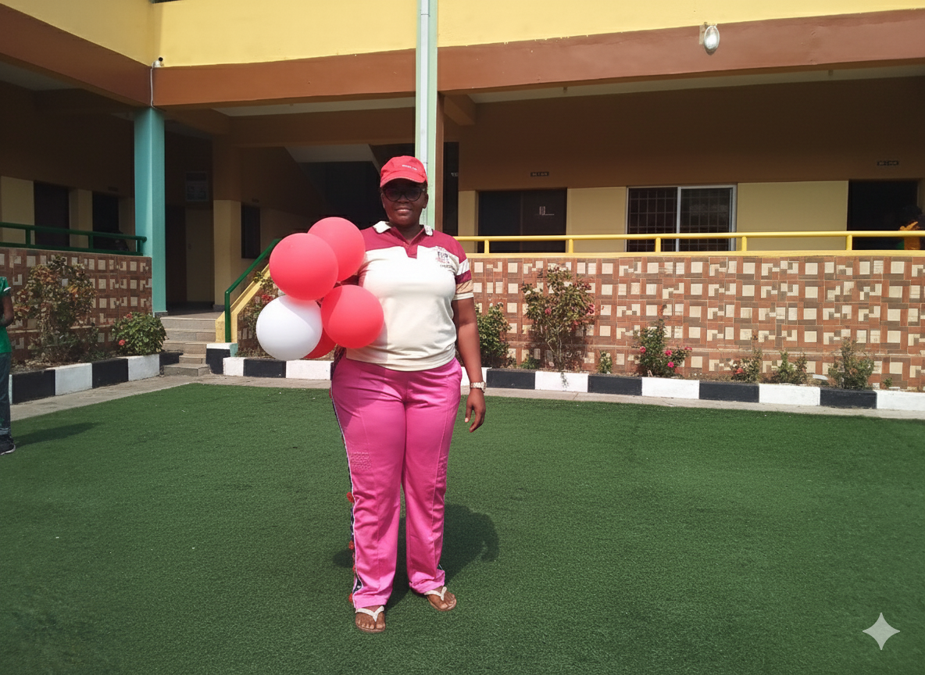
Google Nano Banana
Prompt: remove everybody except the woman on pink trouser at the far left, position her in the middle
31
30
32
29

Slide 31
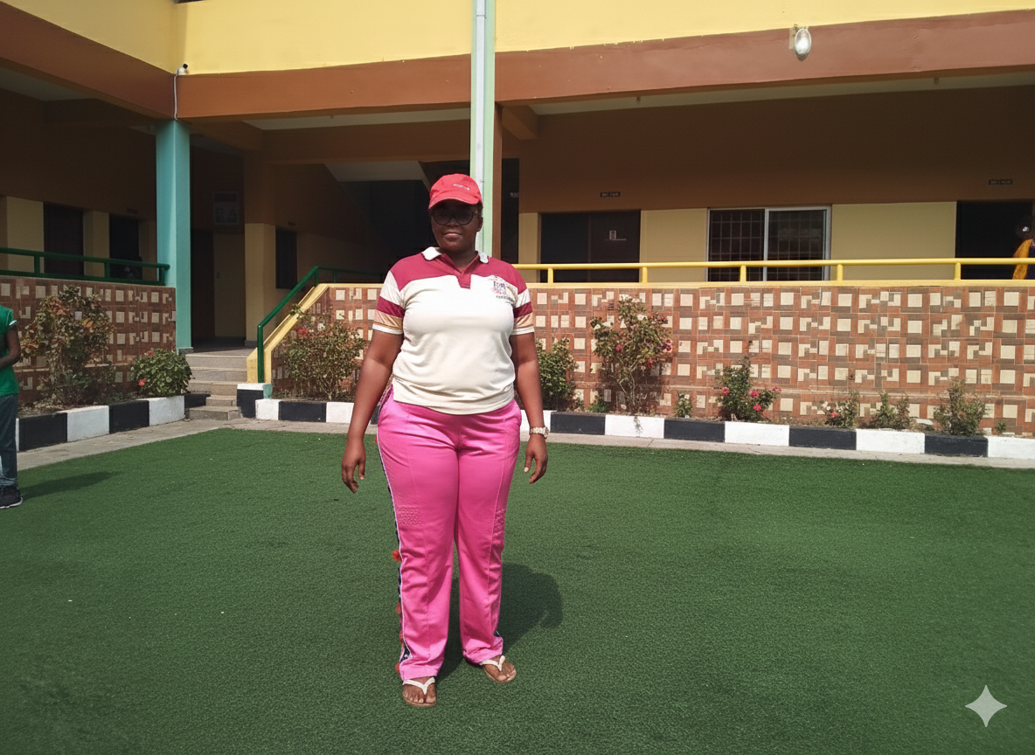
Google Nano Banana
Prompt: remove the balloon
32
31
29
30

Slide 32

Google Nano Banana
Prompt: replace her footwear with fitting sports footwear
32
33
34
31

Slide 33
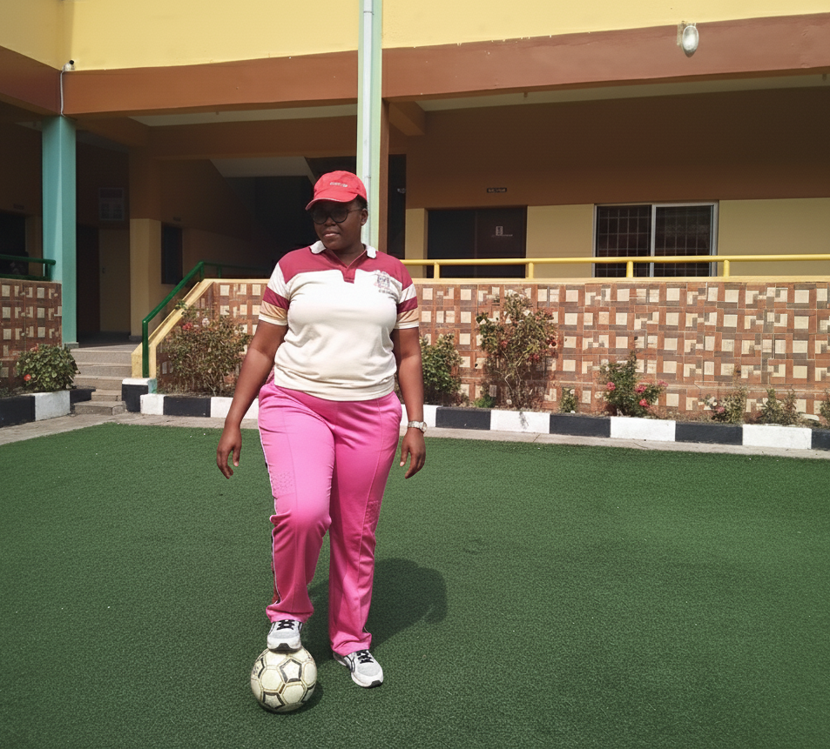
Google Nano Banana
Prompt: place a FIFA football on the ground, make her step on it with her right foot
34
33
35
32

Slide 34
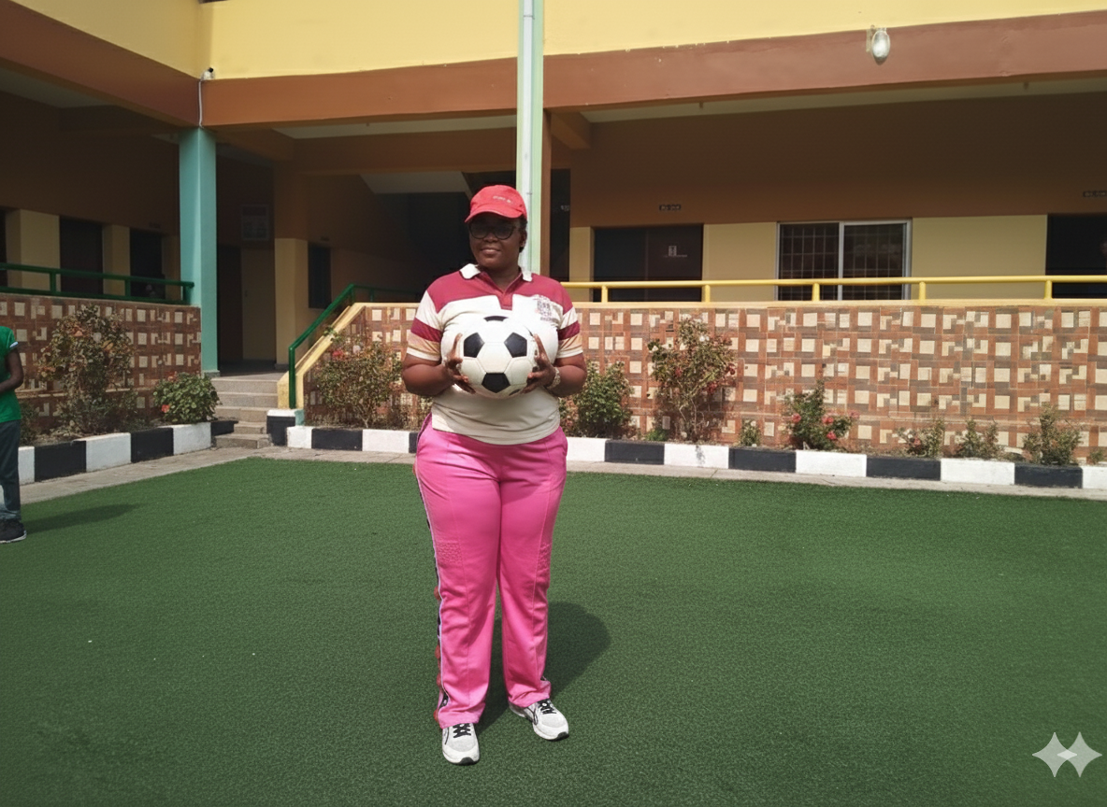
Google Nano Banana
Video 3
Prompt: make her hold FIFA football with both hands
35
34
33
36

Slide 35
ACTIVITY
Think about a classroom behavior you wore, and a rule you have enforced in the past, that you must change to achieve IE.
Share your new resolve with your neighbor right now
36
35
37
34

Slide 36




THE PLEDGE
37
36
38
35

Slide 37
THE PLEDGE
I pledge to honor every learner’s uniqueness by creating an inclusive classroom where all can belong, learn, and succeed.
38
37
39
36

Slide 38

FATHERLY BLESSINGS
Video 4
Video 5
39
38
40
37

Slide 39
CONCLUSION
Differentiated Instruction is not extra work; rather, it is smart teaching. Inclusive Education ensures every child belongs and succeeds.
Fairness is not giving every student the same thing. Fairness is giving every student what they need to succeed.
40
39
38
37

Slide 40





40
39
38
37

